Slide 1
Project Title Presentation
On
“”
By
Guide
-

Slide 2
CONTENTS
Introduction
Problem Statement
Project Scope
Literature Review
Architecture Diagram of Proposed System
Proposed System
Algorithms
Results
Conclusion
References

Slide 3
Introduction
Agriculture plays a vital role in the socio-economic fabric of India.
Failure of farmers to decide on the best-suited crop for the land using traditional and non-scientific methods
It is a serious issue for a country where approximately 58 percent of the population is involved in farming.
Sometimes farmers were failed to choose the right crops based on the soil conditions, sowing season, and geographical location.
This results in suicide, quitting the agriculture field, moving towards urban areas for livelihood.
To overcome this issue, we have proposed a system to assist the farmers in crop selection by considering all the factors like sowing season, soil, and geographical location.

Slide 4
Problem Statement
To recommend the crops, ph, rainfall, industry using machine learning and
deep learning based on soil image, n,p,k and region.

Slide 5
Project Scope
Crop recommendation has always been an area of active interest in the agriculture field.
The crop recommendation are becoming harder to track down because of their use of highly advanced technology
The background of our topic is image processing technology and applying it for the purpose of verifying crop prediction.
The success rate of this software can be measured in terms of accuracy and speed.

Slide 6
Literature Review
Author | Publisher | Year | Name of the paper | Methodology | Problems Found
G. Mariammal et al. | IEEE | 2021 | “Prediction of Land Suitability for Crop Cultivation Based on Soil and Environmental Characteristics Using Modified Recursive Feature Elimination Technique With Various Classifiers” | This work proposes a novel feature selection approach called modified recursive feature elimination (MRFE) to select appropriate features from a data set for crop prediction. | MRFE method will give less accuracy on large dataset.

Slide 7
Literature Review
Author | Publisher | Year | Name of the paper | Methodology | Problems Found
John Carlo V. Puno1 et al. | IEEE | 2020 | “Soil Nutrient Detection using Genetic Algorithm” | In this paper Genetic Algorithm is the method used in this study in classifying the qualitative level of the soil nutrients. The extracted features were the HSV values and the LAB values color space. | Do not works on large dataset.

Slide 8
Literature Review
Author | Publisher | Year | Name of the paper | Methodology | Problems Found
R. Reshma et al. | IEEE | 2020 | “IoT based Classification Techniques for Soil Content Analysis and Crop Yield Prediction” | The proposed IoT system is composed of pH sensors, Humidity and temperature sensors, Soil moisture sensors, soil nutrient sensors and finally For the recommending the crops using SVM and Decision Tree algorithm. | Require memory to store the continuous data.

Slide 9
Literature Review
Author | Publisher | Year | Name of the paper | Methodology | Problems Found
Sonal Jain et al. | IEEE | 2020 | “Machine Learning convergence for weather based crop selection” | Machine learning algorithms such as Recurrent neural network is used for weather prediction, and Random forest classification algorithm is used to select suitable crops. | Need large dataset for random forest otherwise occurring over fitting problem.

Slide 10
Literature Review
Author | Publi-sher | Year | Name of the paper | Methodology | Problems Found
S.R.Rajeswari , Parth Khunteta, et al. | IJITEE | 2019 | “Smart Farming Prediction Using Machine Learning” | These paper mainly focus on the algorithms such as SVM used to predict crop yield ,crop cost prediction. | Requires important features for classification.

Slide 11
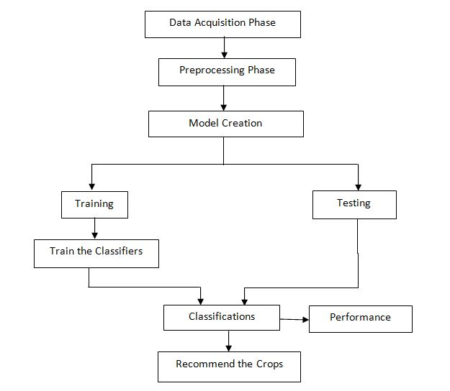
Architecture Diagram

Slide 12
Proposed System
We are going to overcome existing problem of crop prediction based on soil detection accuracy and diversity of soil images.
The step-by description of the procedure of proposed system is as follows:
1) Soil data acquisition;
2) Preprocessing of data
3) Segment the components using CNN algorithm
4) Obtain the useful segments to classify the soil image and provide the soil color
5) SVM recommend the crops region-wise

Slide 13
Implementation
A] Dataset Gathering
Every Machine Learning model works on the data.
The dataset gathering is first step of any machine learning or deep learning project.
We have collected the dataset of soil from kaggle platform.
The dataset contains total 812 images of soils which are alluvial, black, clay and Red soil image colors.
We have split the data into two parts:
1] Training
The training folder contains 656 images. Basically the CNN model will learn
the features on training data.

Slide 14
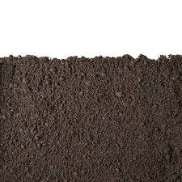
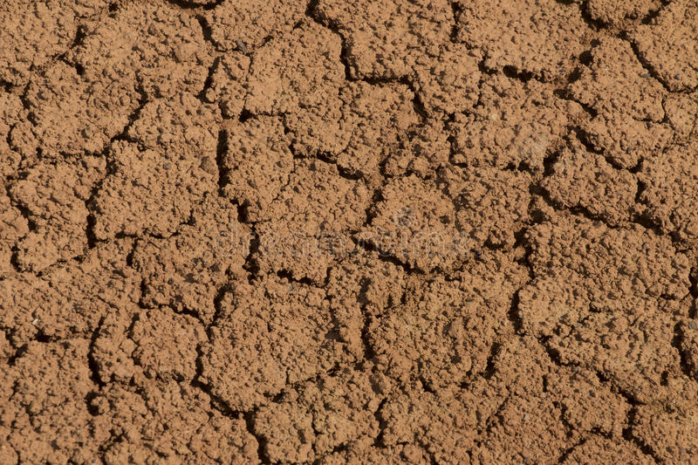
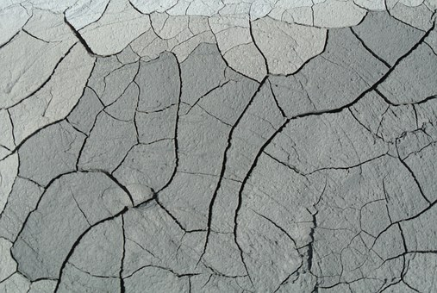
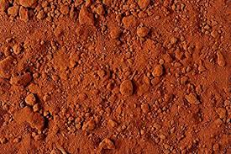
Cont…
2] Testing
The testing folder contains 156 images. This test data will check the performance of
Model on trained data.

Slide 15
Cont…
B] Dataset Pre-Processing
The dataset contains different sizes of every image.
In that we are converted the every image into standard size. i.e. (224*224).
C] Data Augmentation
In this step we are performing some transformations on images such as rotate the
Image into 40 degree/angle, zoom the image with 0.2 scale factor and changing the
Contrast of original image.
D] Model Training
In this step we have trained the model with 20 epochs and we got the 91.6% accuracy.

Slide 16

Algorithm
Conventional Neural Network (CNN)
CNN takes in processed images as input.
Extracts different features about the images regardless of their position using a series of mathematical operations to identify the pattern.
Every layer in CNN has API which transforms input to output with differentiable functions.

Slide 17

Cont…
Convolutional Layer
Pooling
Flattening
Fully Connection
Figure: CNN Architecture

Slide 18

Cont…
2. Pooling Layer
The function of pooling is to continuously reduce the dimensionality to reduce the number of parameters and computation in the network. This shortens the training time and controls over fitting
Max Pooling extracts out the highest pixel value out of a feature while average pooling calculates the average pixel value that has to be extracted.

Slide 19
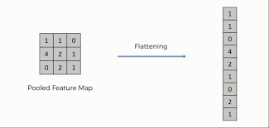
Cont…
3. Flattening
Basically here we arrange the pooled feature into a single vector/column as a input for next layer(convert our 2D data to 1D)

Slide 20
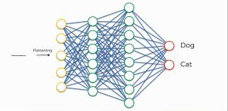
Cont… 4. Fully Connected Layer Neurons in a fully connected layer have full connections to all the activations in the previous layer. Combining more neurons to predict more accurately.

Slide 21
Cont..
2. Random Forest
Random forest is a Supervised Machine Learning Algorithm that is used widely in Classification and Regression problems.
It reduces the overfitting problems.
It builds decision trees on different samples and takes their majority vote for classification.
In this project we are predicting Rainfall, Temperature, Crops by using random forest model.

Slide 22
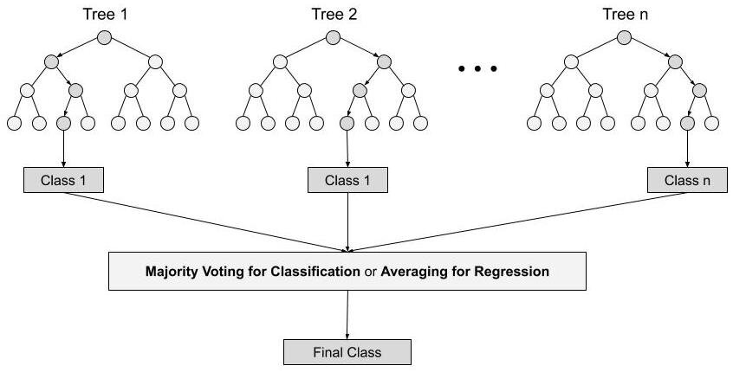
Cont…

Slide 23
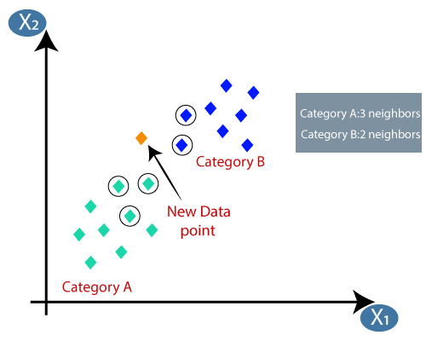
3. KNN
A refinement of the k-NN classification algorithm is to weigh the contribution of each of the k neighbors according to their distance to the query point, giving greater weight to closer neighbors.
The KNN classifier suggesting the shop details based on the nearest distance.

Slide 24
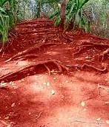
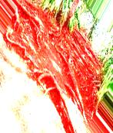
Results
Resized Image
Rotated Image

Slide 25
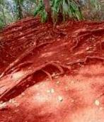
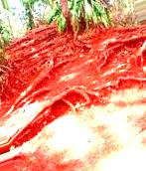
Results
Zoom Image
Brighter Image

Slide 26
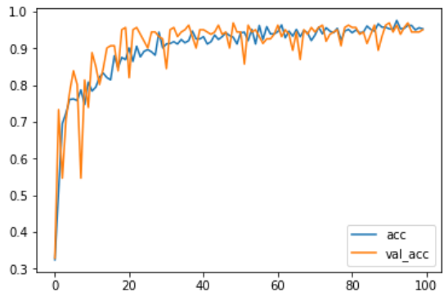
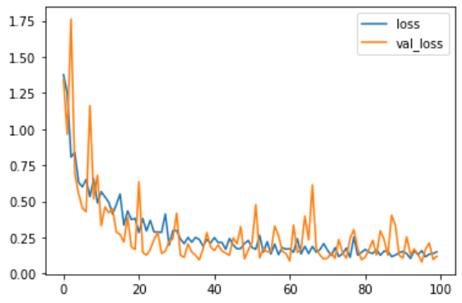
Results
Accuracy Graph
Loss Graph

Slide 27


Results
Registration page
Login page

Slide 28
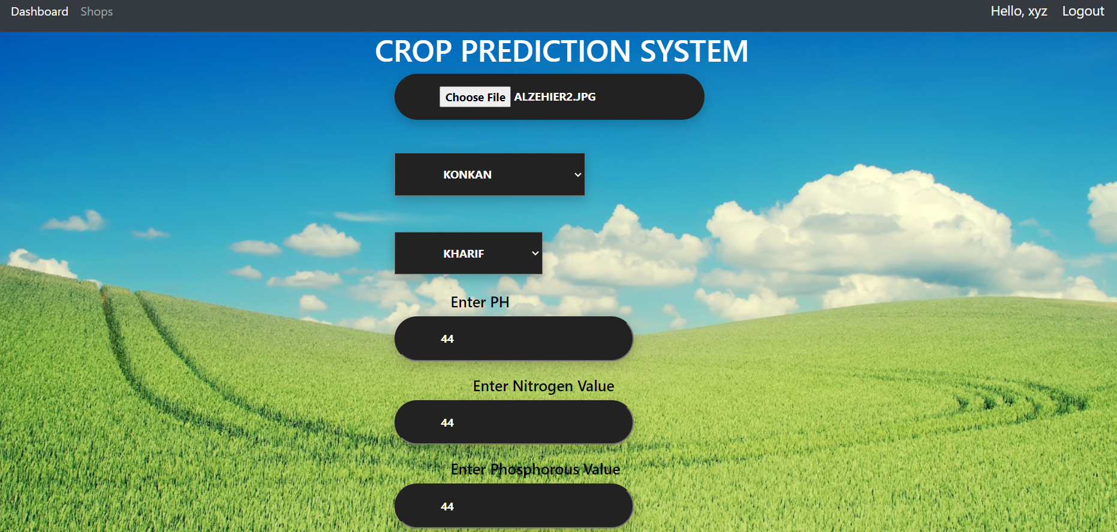
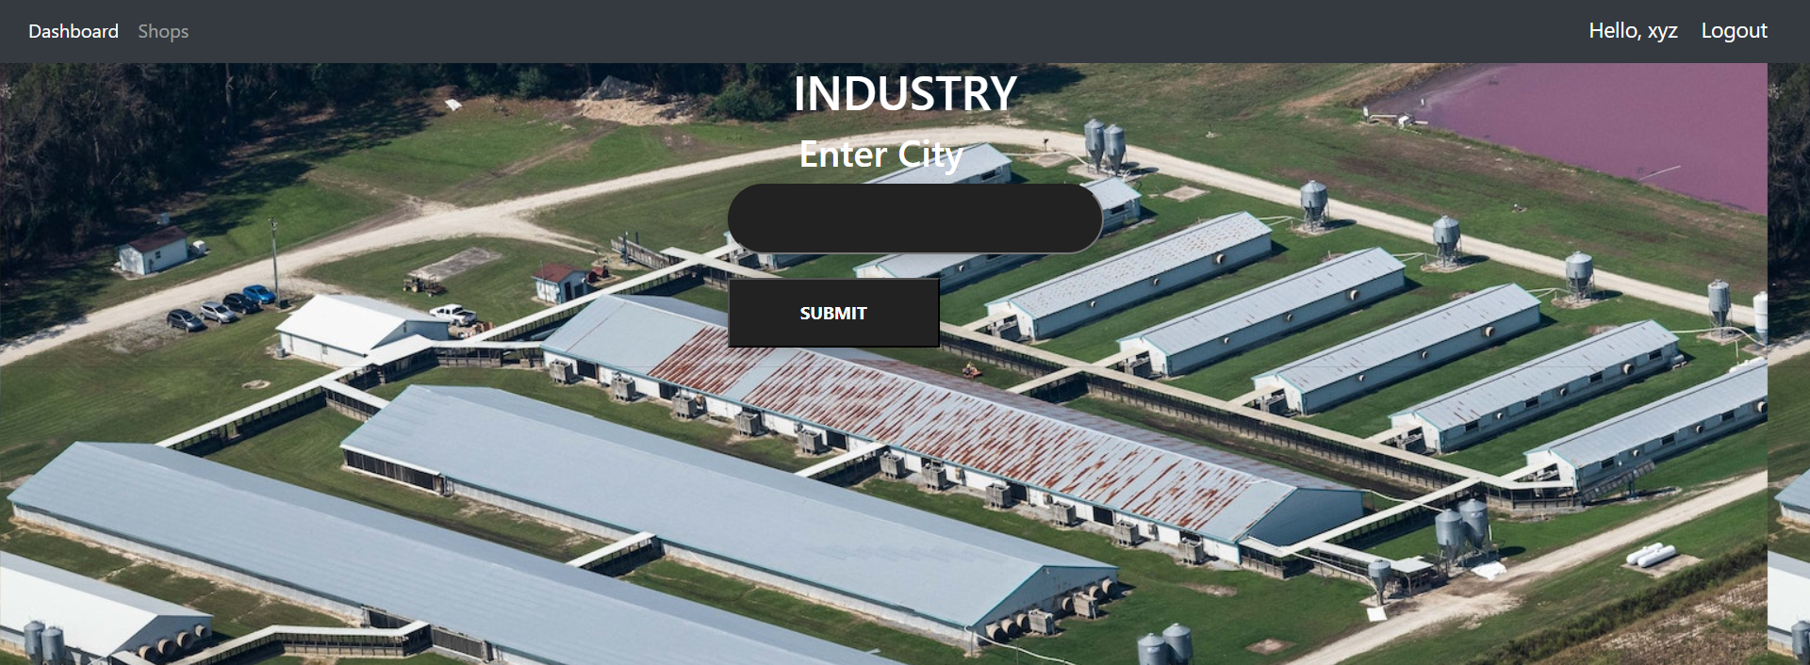
Results
Home page
Home page

Slide 29
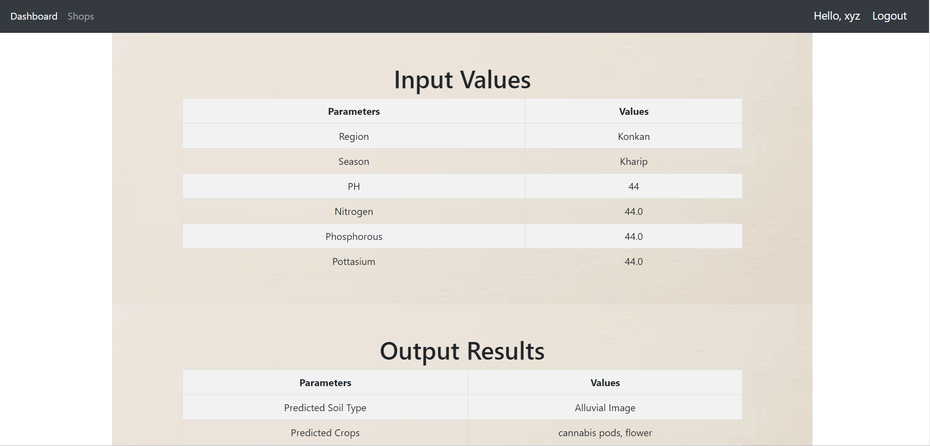
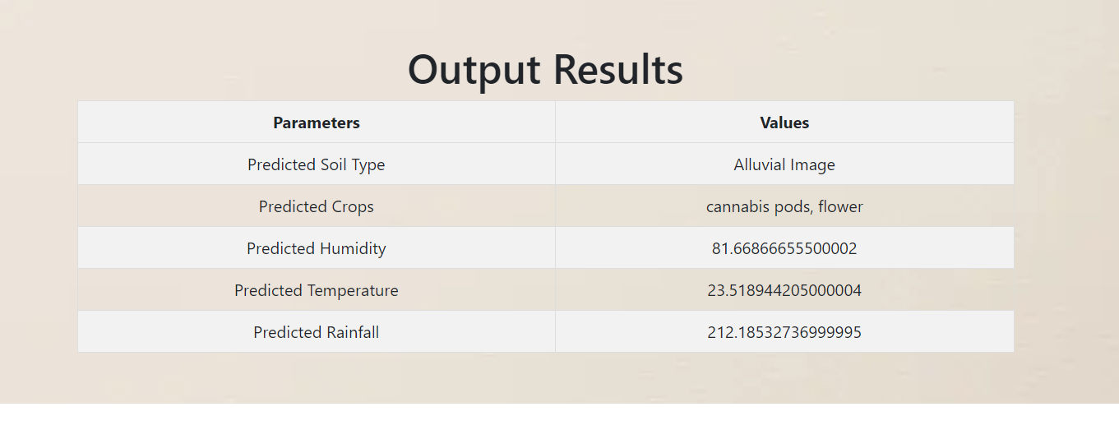
Results
Result Page

Slide 30
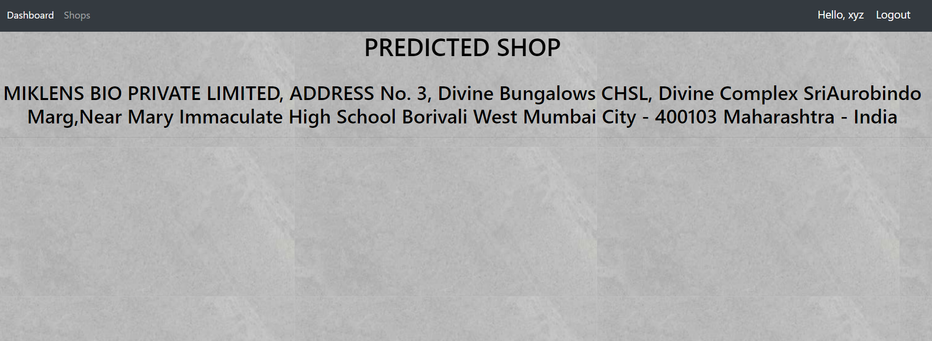

Results
Recommend the shop
Recommend the shop

Slide 31
Conclusion
In this project we recommend the crops using machine learning and deep learning
Algorithms and we get the 91.23% accuracy . In this system we will take the image
from user and region and based on that we will recommend the crops. Also we are
recommend the industry to farmer to sell the crops by KNN classifier.

Slide 32
REFRENCES
[1] S.R.Rajeswari , Parth Khunteta, Shubham Kumar, Amrit Raj Singh, Vaibhav Pandey “Smart Farming Prediction Using Machine Learning” International Journal of Innovative Technology and Exploring Engineering (IJITEE).
[2] John Carlo V. Puno1 , Rhen Anjerome R. Bedruz1 , Allysa Kate M. Brillantes “Soil Nutrient Detection using Genetic Algorithm” Manufacturing Engineering and Management Department IEEE.
[3] R. Reshma, V. Sathiyavathi and T. Sindhu et al. “IoT based Classification Techniques for Soil Content Analysis and Crop Yield Prediction” Proceedings of the Fourth International Conference on I-SMAC (IoT in Social, Mobile, Analytics and Cloud) (I-SMAC).
[4] Sonal Jain, Dharavath Ramesh, “Machine Learning convergence for weather based crop selection” 2020 IEEE International Students’ Conference on Electrical, Electronics and Computer Science.

Slide 33
Cont…
[5] G. Mariammal , A. Suruliandi , S. P. Raja , and E. Poongothai “Prediction of
Land Suitability for Crop Cultivation Based on Soil and Environmental
Characteristics Using Modified Recursive Feature Elimination Technique With
Various Classifiers” IEEE TRANSACTIONS ON COMPUTATIONAL SOCIAL
SYSTEMS.

Slide 34
Thank You

